Slide 1
Oksana stepanova
Case study
GetTaxi Technology platform:
Analysis of failed orders

Slide 2

Analysis overview
Gett, previously known as GetTaxi, is an Israeli-developed technology platform solely focused on corporate Ground Transportation Management.
They have an application where clients can order taxis, and drivers can accept their rides (offers).
At the moment, when the client clicks the Order button in the application, the matching system searches for the most relevant drivers and offers them the order.
In this analysis, we would like to investigate some matching metrics for orders that were not completed successfully, i.e., the customer didn't end up getting a car.

Slide 3

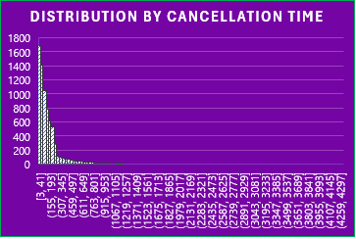
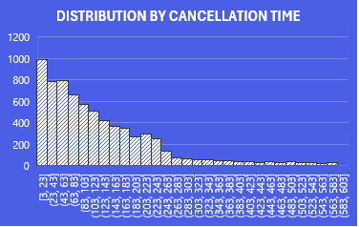
Challenges & solutions Data integrity & constancy: outliers
RAW DATA
AFTER REMOVING OUTLIERS
Criteria | order_datetime | estimated_time_of_arrival | cancellations_time_in_seconds
Minimum | 12:00:02 AM | 60 | 3
Maximum | 11:59:59 PM | 1559 | 4303
Mean | n/a | 441 | 158
Q1 | n/a | 233.00 | 45.00
Q2 | n/a | 368.50 | 98.00
Q3 | n/a | 653.25 | 188.00
There are 318 values which is greater than the upper outlier bound and this is equal to 4.3 % of all values in this columns.
I have removed 318 values which are greater than the upper outlier bound and plotted a distribution plot and scatter plot. As a result, the distribution of data point are better normalized.
Data Profile

Slide 4
Analysis &insights which category has the highest number of cancelled orders?
cancelled orders by driver assigned key
More than 70% of orders were cancelled before the driver was assigned.
My assumptions of why the orders were cancelled based on the two values for the clients which are time and cost of the ride:
Clients cancel orders because the estimated arrival time is not acceptable for their current needs.
Clients just check the cost of the ride.
Clients compare the time and cost and select another transit option.
My further steps will be analyzing
Who cancelled the order (client or system)
Dynamic of cancelled orders over the day
Relationship between the number of cancelled orders and the estimated arrival time

Slide 5
Analysis &insights who cancelled orders?
cancelled orders by client or system
If the driver is assigned, 100% of orders were cancelled by clients.
Why? Let’s look at the trend: orders cancelled by hours, Estimated Arrival Time (EAT) and cancelled orders
If the driver was not assigned about 60% of orders were cancelled by clients and 40% by the system.
When do clients most likely cancel the order? How long are they willing to wait? Does it depend on the hour of the day?

Slide 6
Analysis &insights Cancelled orders over the day how it is associated with arrival time
ORDERS CANCELLED BY CLIENTS WHEN DRIVER IS ASSIGNED
There are three evident periods of time during the day when the number of cancelled orders is rising. Two of them are when people moving to and from the office, e.g. 7 am - 9 am and 4 pm – 6 pm. And then at late hours 10 pm – 12 am.
The estimated arrival time has the same rising trend during these hours across the day.
While the cancelation time doesn’t show significant variations throughout the day. However, the graph displays that the cancellation time has downward trend during the rush hours.
We witness the evident trend: as long and the arrival time increases, the more orders are being canceled.
The time they spend for ride are extremely crucial for customers and they are not willing to wait for the driver’s arrival for more than 5 min.

Slide 7
Recommendations & further steps
The arrival time is of primary importance for customers.
Introduce the improvements to match better the driver and the customer’s location and reduce the waiting time.
Estimate and increase the number of drivers during the rush hours.
Assuming that the arriving time may be affected by the traffic jam during the rush hour, improve the logistics to avoid overloaded roads.
Elaborate the compensations program or cash reward in case the driver has arrived later that the estimated time with the reasonable margin of allowance.
I assume that the two major factors that may affect the customers’ loyalty which are rite time and the cost of the ride.
In addition to the relationship between canceled orders and the expected arriving time, the following factors should be analyzed:
The estimated and real time of arrival.
The cancelled orders and the declared cost.
The variation of orders placed and the number of drivers who are ready to provide taxi services throughout the day, week.
Analyze the trends on working days and weekends separately.
Analyze the location of customers and the real disposition of the drivers during the busiest hours. Look at the insights that can provide the special analysis.

Slide 8
THANK YOU!
Oksana stepanova

